Slide 1
Greg Focaccio - Employee Brief
Greg Focaccio
Code #
IT Specialist
Month Day, 2025
1

Slide 2


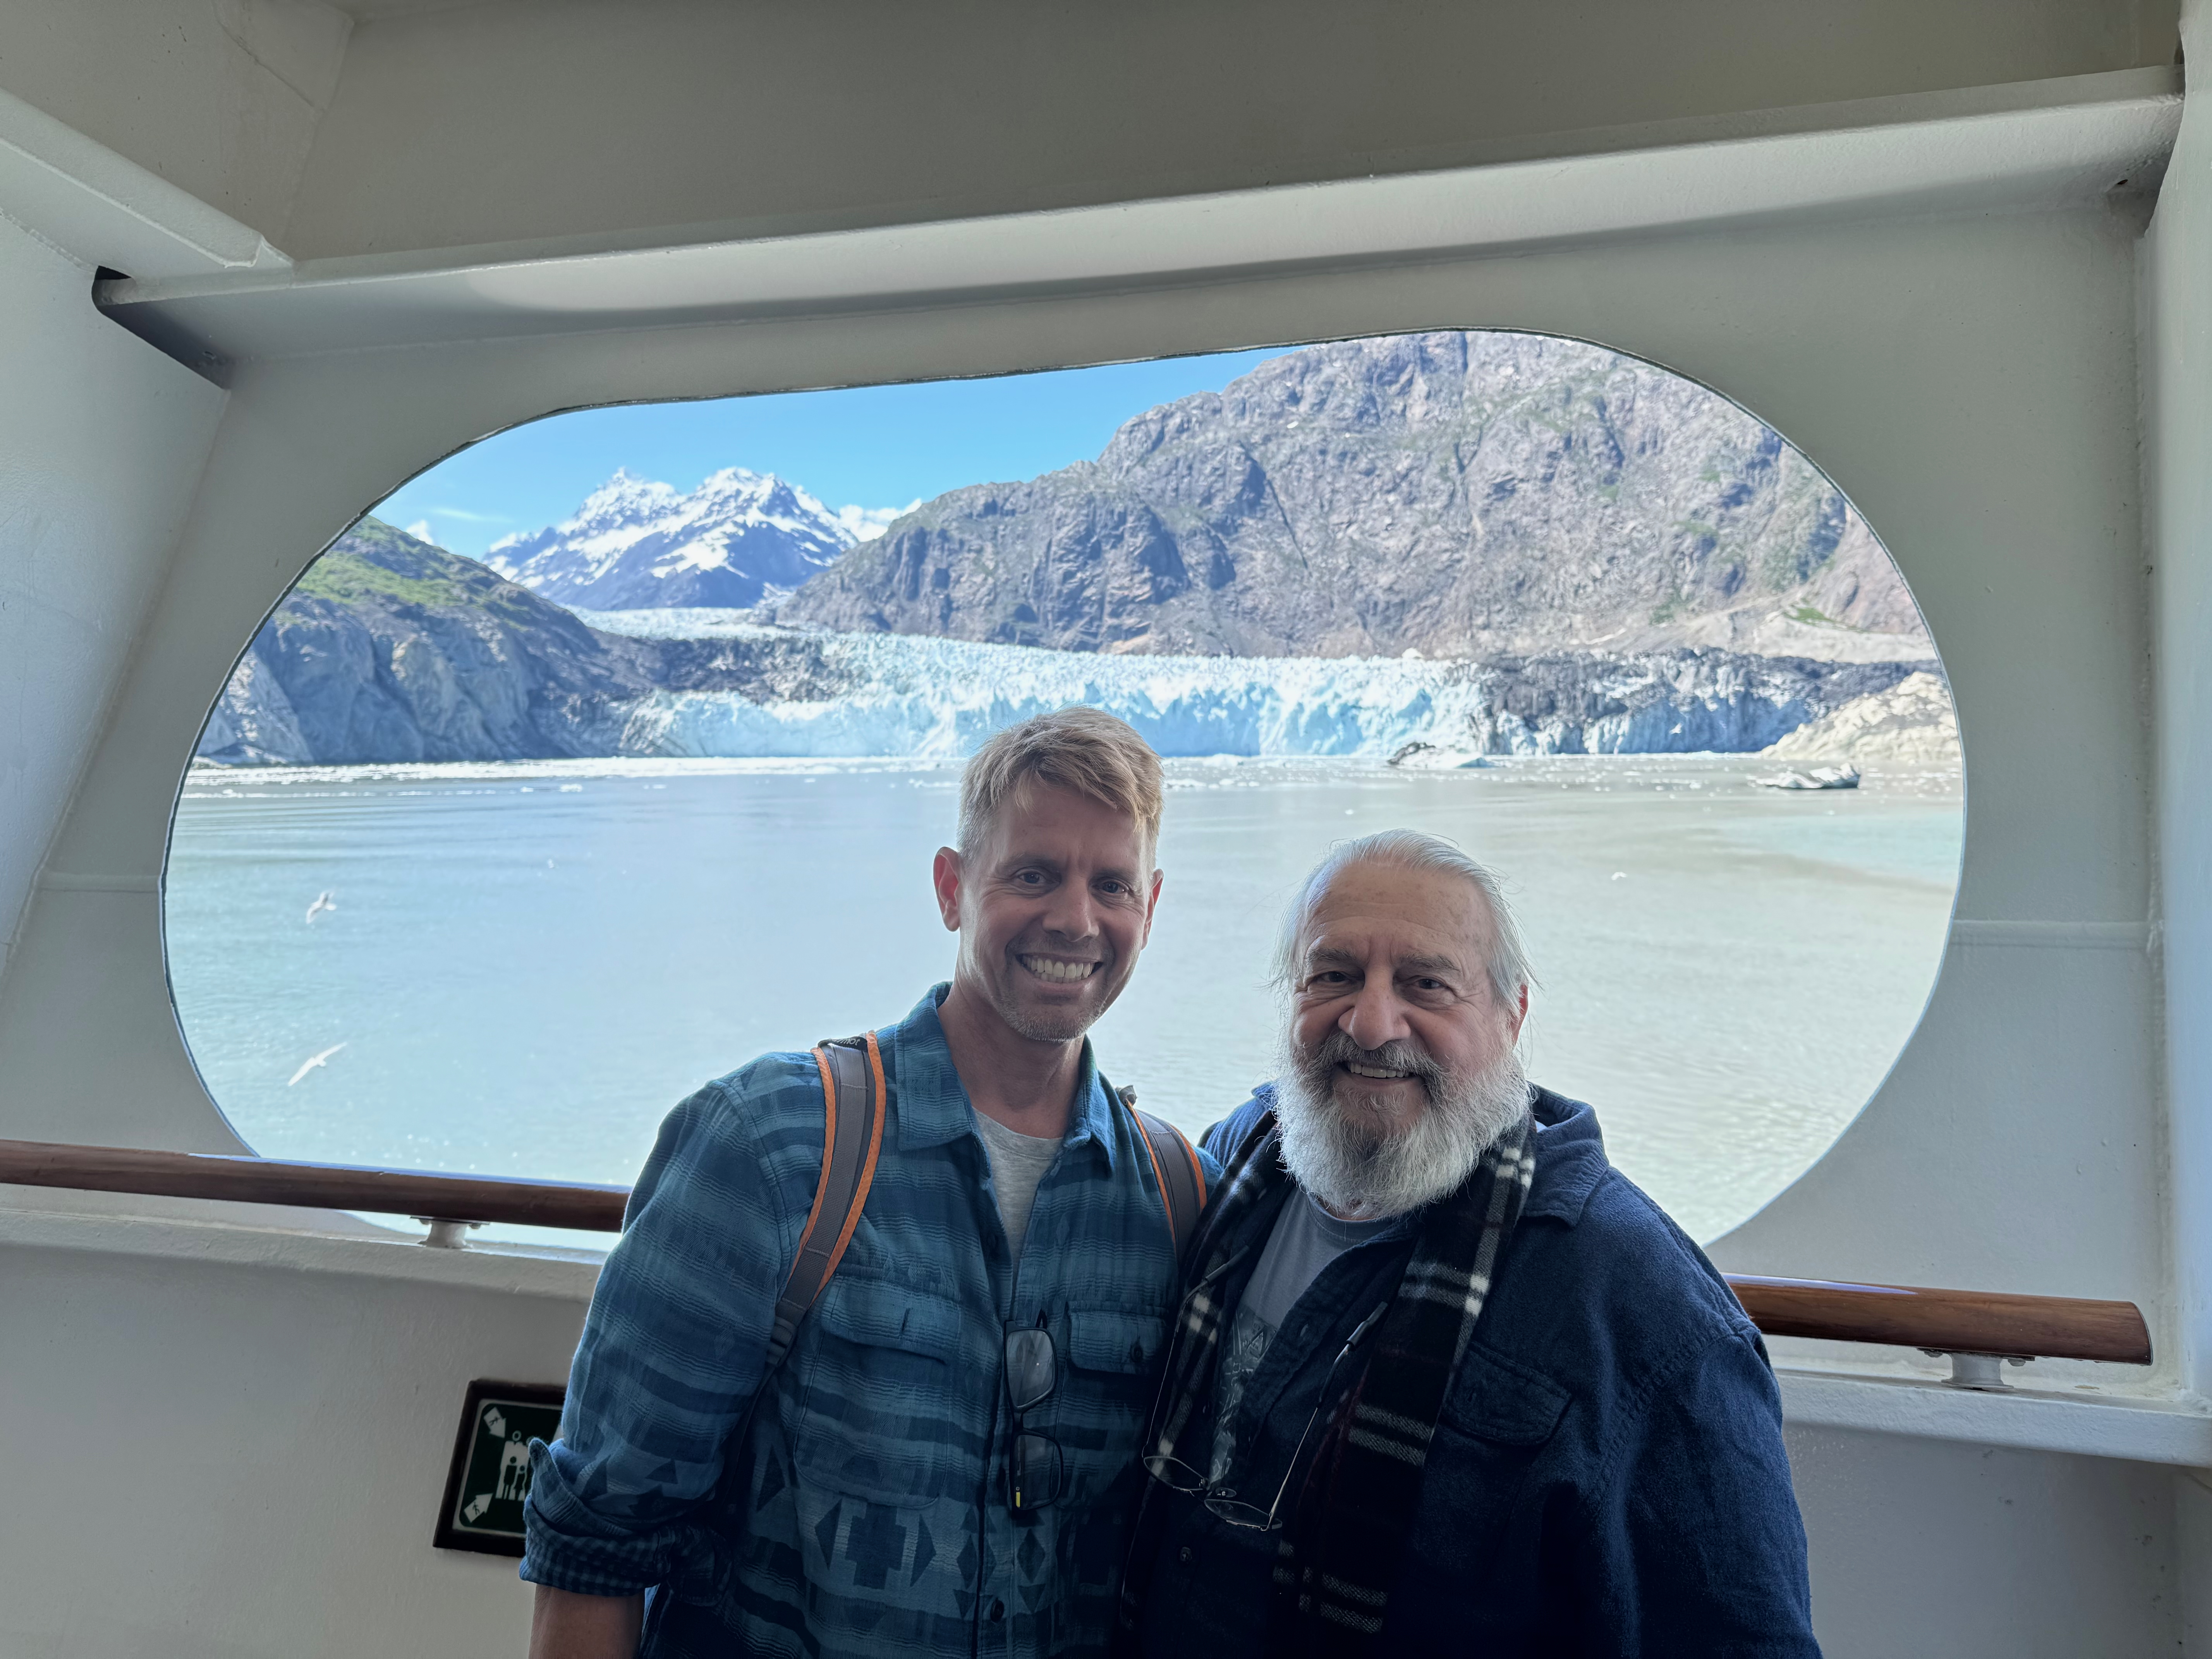

Personal
Photo of San Diego
Mission
Photo of Beach
Scripps Pier
2

Slide 3
Personal
Personal
Native San Diegan
Home in Tierrasanta
Married for 16 years
Three children at home
12 Daughter, 9 Son , 4 Daughter
Three grown step-children
Out of the home with 4 grandkids
One Step-Daughter is a Senior Airman Rank [X] in Airforce at Beal AFB married to an Airman
One Step-Daughter is married to an Army Sergeant soon to be stationed at Fort Irwin near Barstow
Interests / Pets / Fun Facts
Garage Network Lab
Enjoy learning new Network technologies
Gardening - Enjoy growing Native Plants and Cacti
Outdoors Activities - Camping, Hiking, Bodysurfing, Tennis
Pets - Desert Tortoise, Small Poodle
Fun Facts
Born the day of the Apollo 11 Moon launch
Been to Egypt and inside King’s Chamber of Great Pyramid (1991)
Marathon Finisher - SD Rock N’ Roll (2007, 2010)
Summited San Jacinto (10,834 ft near Palm Springs)
Goal to Summit Mt. Whitney (next year or two)
First computer - IBM PC with two floppy drives
Programmed Basic, Fortran, Pascal in High School
Drove down Baja California to Cabo San Lucas (2008)
3

Slide 4

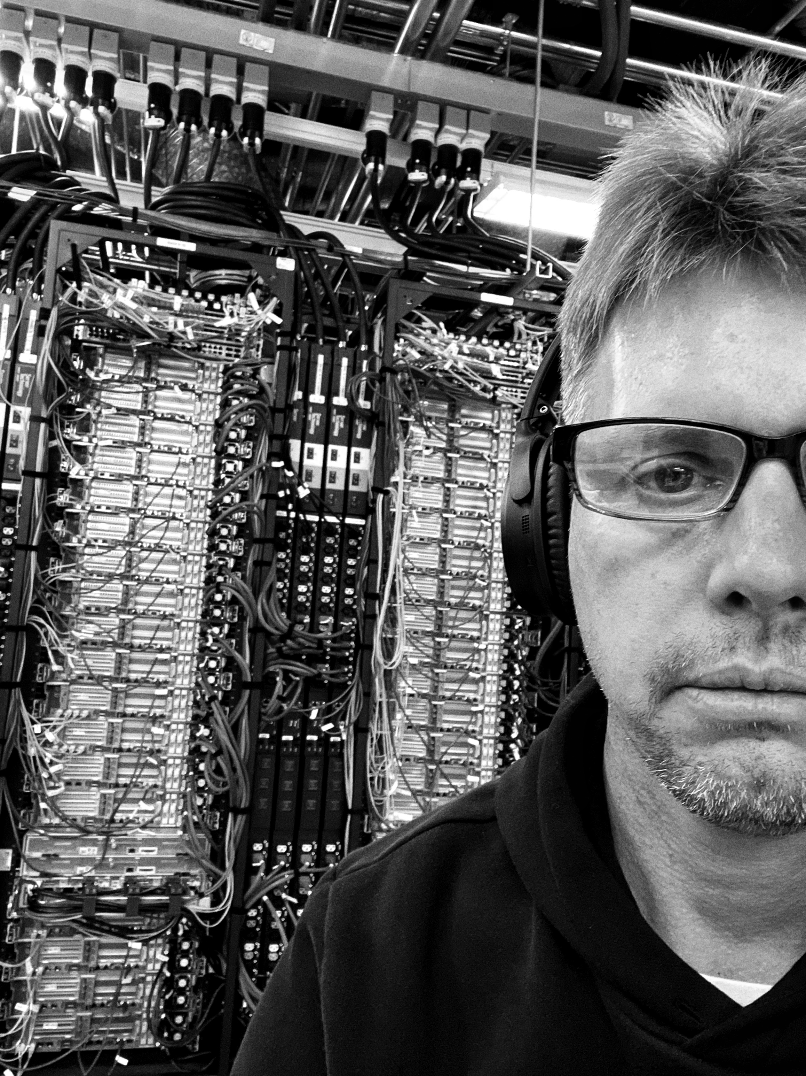
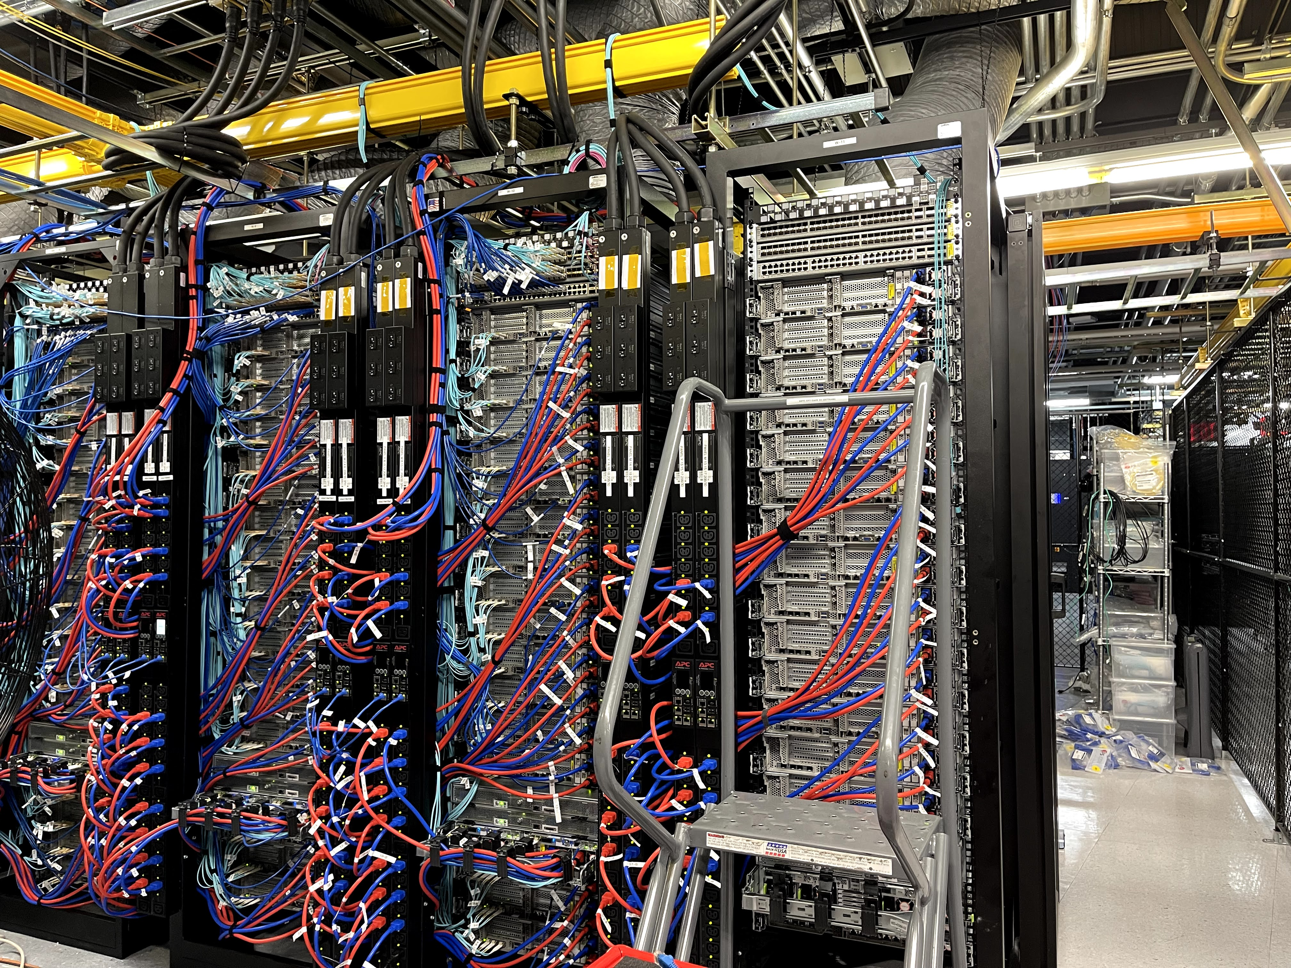
Work
7

Slide 5
Greg Focaccio – Background, Pre-NIWC
Education
Pomona College, BA Biology, Cum Laude 1991
Medical School (Incomplete) 1992-1995
Adult School / Cisco Network Academy Southwestern College
Work Experience
15+ Years across the full spectrum of types of Network Work
Design and Engineering
Implementation and Infrastructure
Operations and Troubleshooting
Prior to NIWC PAC
1 Year – Principal Network Engineer – SD Datacenter ISP (M5 Hosting) 2021
2 Years – (DoD) SIPR Transport NMCI (Perspecta) 2018-2020
2 Years – Principal Network Engineer – SD Datacenter ISP (CARI.net)
3 Years – Senior Network Engineer – Network ISP and VoIP Provider (NextLevel Internet)
3 Years – Partner Network Engineer – Network Consulting Company (GoNet Forward)
4 Years – Junior Network Engineer – Network Services Company (Network Insight)
Certifications
CCNP Cisco Certified Network Professional (Past)
Security+ (Current)
Professional
Previous Work
15 years of hands-on Network Engineering experience
Worked as Lead Engineer at multiple Internet Service Providers and network consulting companies
NIWC PAC
Joined 4 years ago (2021), working on X Project in Code X as contractor
Became Civilian Navy 2 years ago (2023)
Hope to remain here for the duration of my career
Made key technical contributions to the X project
Plan to continue work as technical contributor
Open for opportunities to begin managing technical teams
Professional
Previous Work
15 years of hands-on Network Engineering experience
Worked as Lead Engineer at multiple Internet Service Providers and network consulting companies
NIWC PAC
Joined 4 years ago (2021), working on X Project in Code X as contractor
Became Civilian Navy 2 years ago (2023)
Hope to remain here for the duration of my career
Made key technical contributions to the X project
Plan to continue work as technical contributor
Open for opportunities to begin managing technical teams
6

Slide 6
Greg Focaccio - NIWC PAC - Career, Current
4th Year at NIWC PAC – Since Summer 2021
Network Engineer with same Branch / Project
NAME and Purpose of Code/Branch
2nd Year as Navy Civilian – Since Spring 2023
IT Specialist (Network Lead)
Develop and Refine Network Roadmap
Support wider view and longer-term objectives coming from NAVWAR and Program Office
Provide novel capabilities and ideas to NAVWAR and PO via Team IPT and LE
Network RDTE - Create Engineered and Tested Solutions, Capabilities, and Integrations
Network Implementations - Support Fleet and Lab Build-Outs, Modernizations, and Integrations
Network Operations– Back-stop for Fleet Operations, Incident Management (CASREPs), and Troubleshooting
8

Slide 7
Greg Focaccio - NIWC PAC – Project Accomplishments
Fleet
Engineered key cybersecurity improvement, satisfying major FCC Program requirement
Delivered key cybersecurity requirement to Fleet enabling Major Milestone (cutover) for Project
System accepted on DATE as modernized replacement for past system within X
Supported initial site implementation of Cybersecurity improvements
Delivered First Network Visibility Capability to System
Supported key external System Assessments
Provided key network engineering required to enable high profile international cooperative functional demonstration of new undersea communication modality
SCITF (Pac X Lab)
Modernized Management of Lab Network
Added New Lab Capabilities
New wide area network (WAN) simulator
Tools and network modeling software
Enabled International Network Link to UK for key capability functional demonstration
9

Slide 8
Greg Focaccio - NIWC PAC – Project Goals
FY 26-28
Fleet
New Network Architecture, Hardware Modernization, New Services
IP addressing, WAN architecture, New virtualized environments
Mature monitoring and management services
Mature Cybersecurity hardening
Identity and Access Management, Zero Trust Architectures
Introduction of Automation
Infrastructure as code
Maintain and grow key integrations and new capabilities
Lab
Maintain and improve lab conformance as Fleet representative engineering and test environment
Develop new approaches to configuration automation and testing automation
Support more system of systems lab integrations to enable more complete E2E testing
10

Slide 9
Greg Focaccio - NIWC PAC - Career, Future
Next 2-3 Years
Continue as technical contributor on project during key modernizations
Learn about and promote openness to working as technical contributor on other high profile network heavy projects
Begin to develop Team leadership experience and training
Open to Initial roles as Technical team lead (IPT)
4 Years out and beyond from present:
Gain experience as Technical team lead
Further out
Mentor as Technical Lead to Junior Technical leads
11

Slide 10
Greg Focaccio – Value from Differences
What Differentiates me that is of value to NIWC PAC
Perspective and Gratitude
Appreciation for the History, Prestige and Mission criticality of the Center
Grateful to be able to contribute to a Mission as an inherent motivation, versus commercial
Career Arc Position and Continuity
Latter in my Career Arc, hope and expect to remain with NIWC and NAVWAR
Continuity provides value, in maintaining state and supporting informed decision making
Qualities
Accept and Enjoy Difficult Challenges – Especially Network Centric
Enjoy working on the edge – Pushing technologies and breaking new ground
Natural Sincerity and Team Orientation
Background rooted in Science - Strong orientation for detail and testing
Imagination - Enjoy conceptualizing new ways of doing things
18

